Slide 1

TEST ON BIGBASKET
DATE : 22/02/2022
PROJECT NO : 04
BY
PRIYANKA KUMAR

Slide 2

CONCEPETS USED IN PROJECT
Locator
Actions
JavaScript Executor
Takes Screenshot
Dropdown
Navigation Commands
Waits/Sleep
Assert

Slide 3

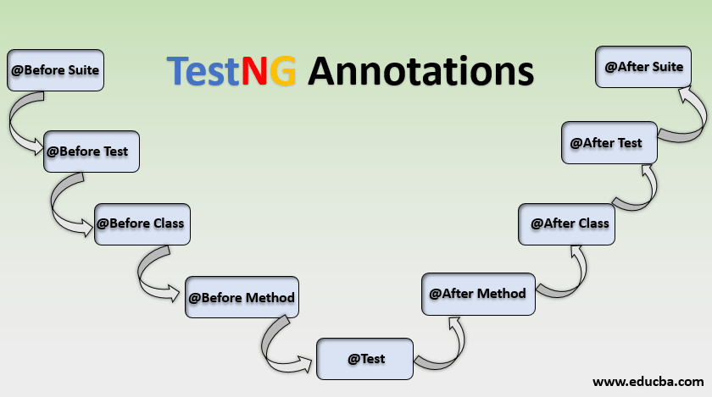
FRAMEWORKS USED IN PROJECT
MAVEN
A Folder Structure and Resolve Dependencies
TESTNG
The Program flow , Tests , suites and Assertions
Annotations
@BeforeTest
@Test(Prority)
@AfterTest
@DataProvider
Test Suite – testing.xml

Slide 4
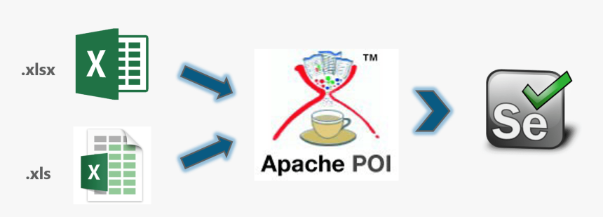
Data Driven
Read and Print the Excel Data using Apache POI

Slide 5
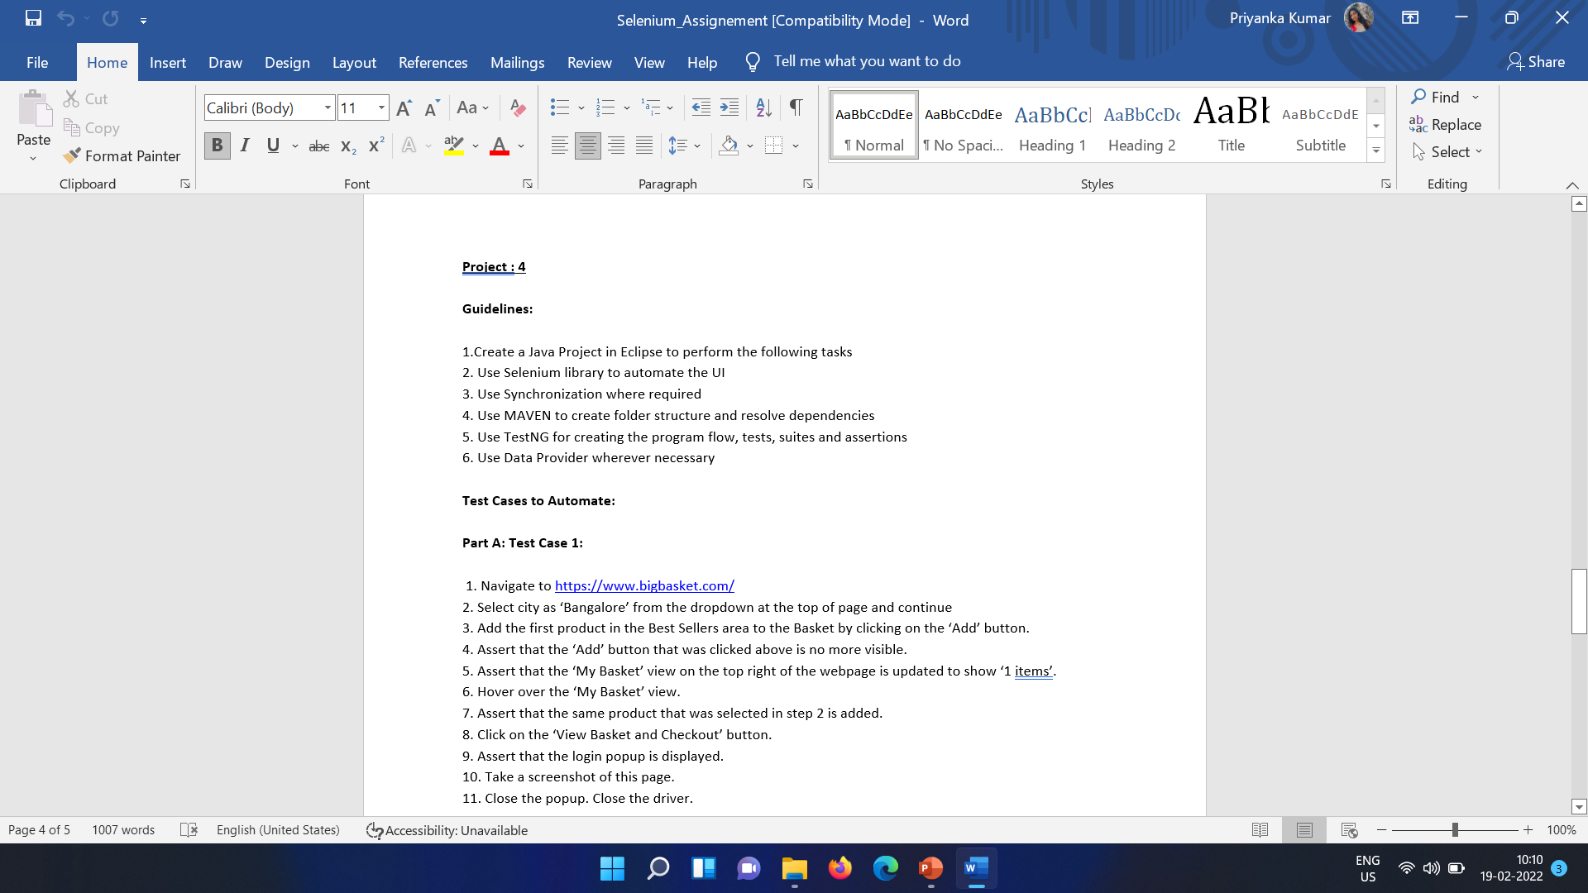
REQUIREMENTS (TEST CASE 1) PART A:

Slide 6
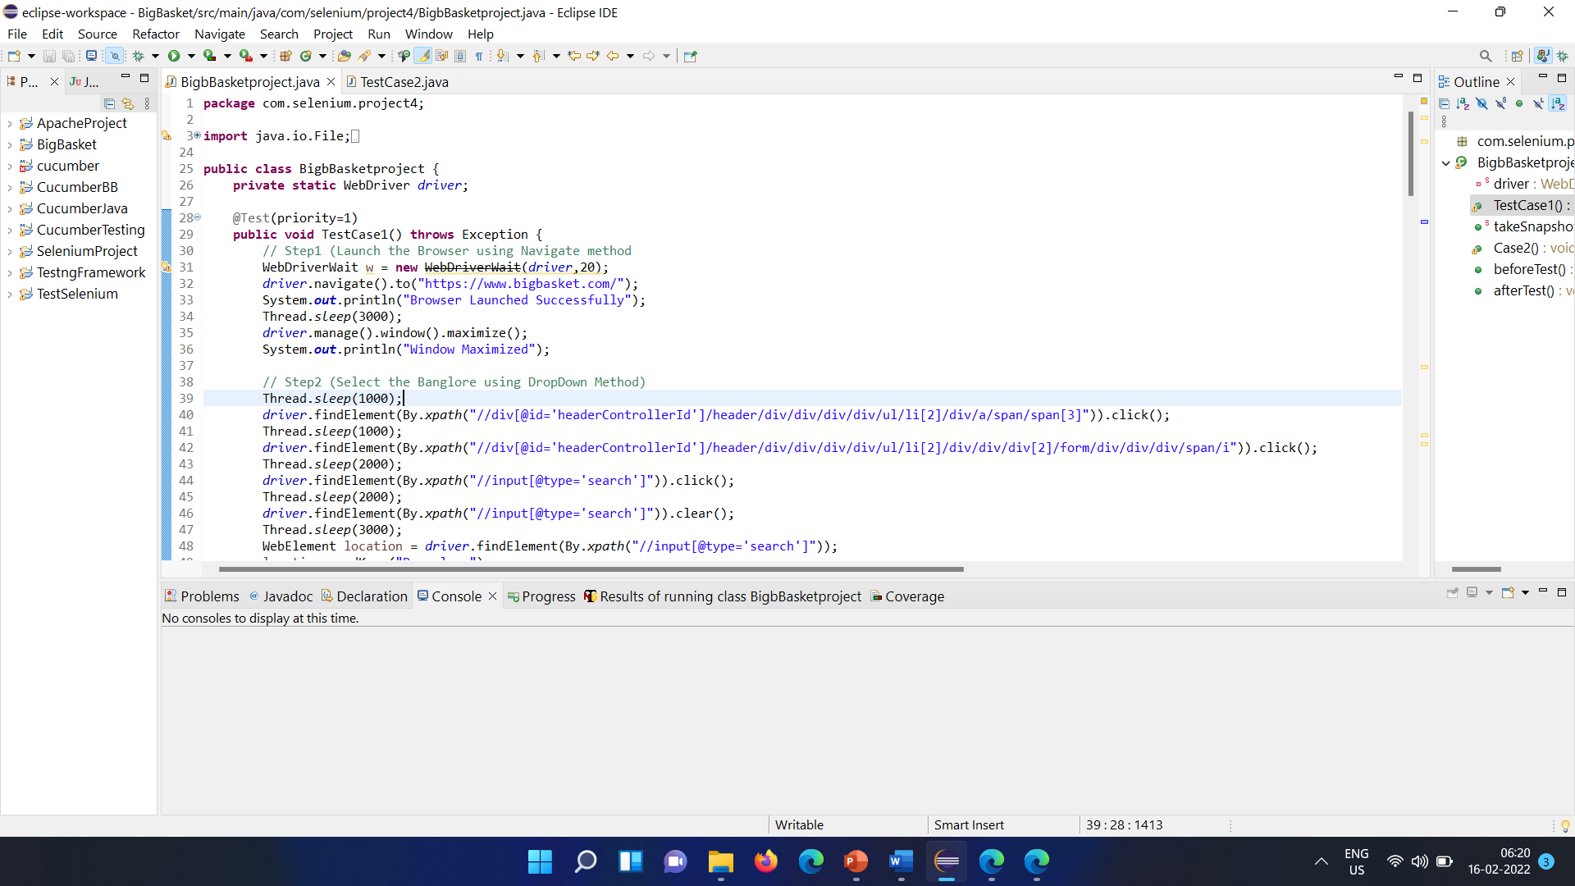
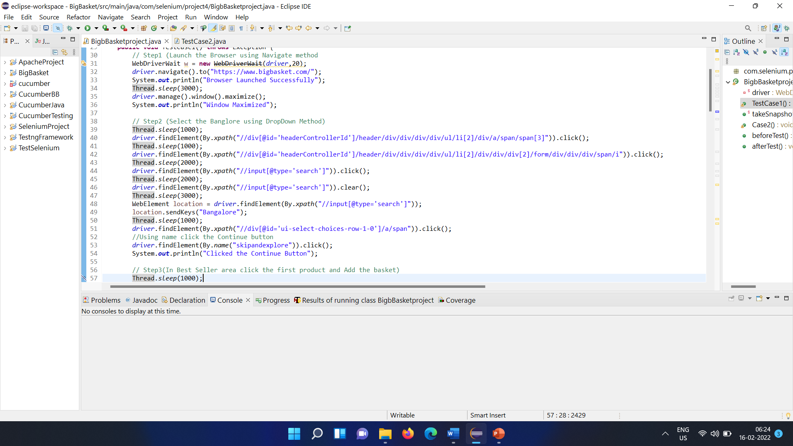
PROJECT STEPS
STEP 1
Navigate to https://www.bigbasket.com/
STEP 2
Select city as ‘Bangalore’ from the dropdown at the top of page and continue

Slide 7
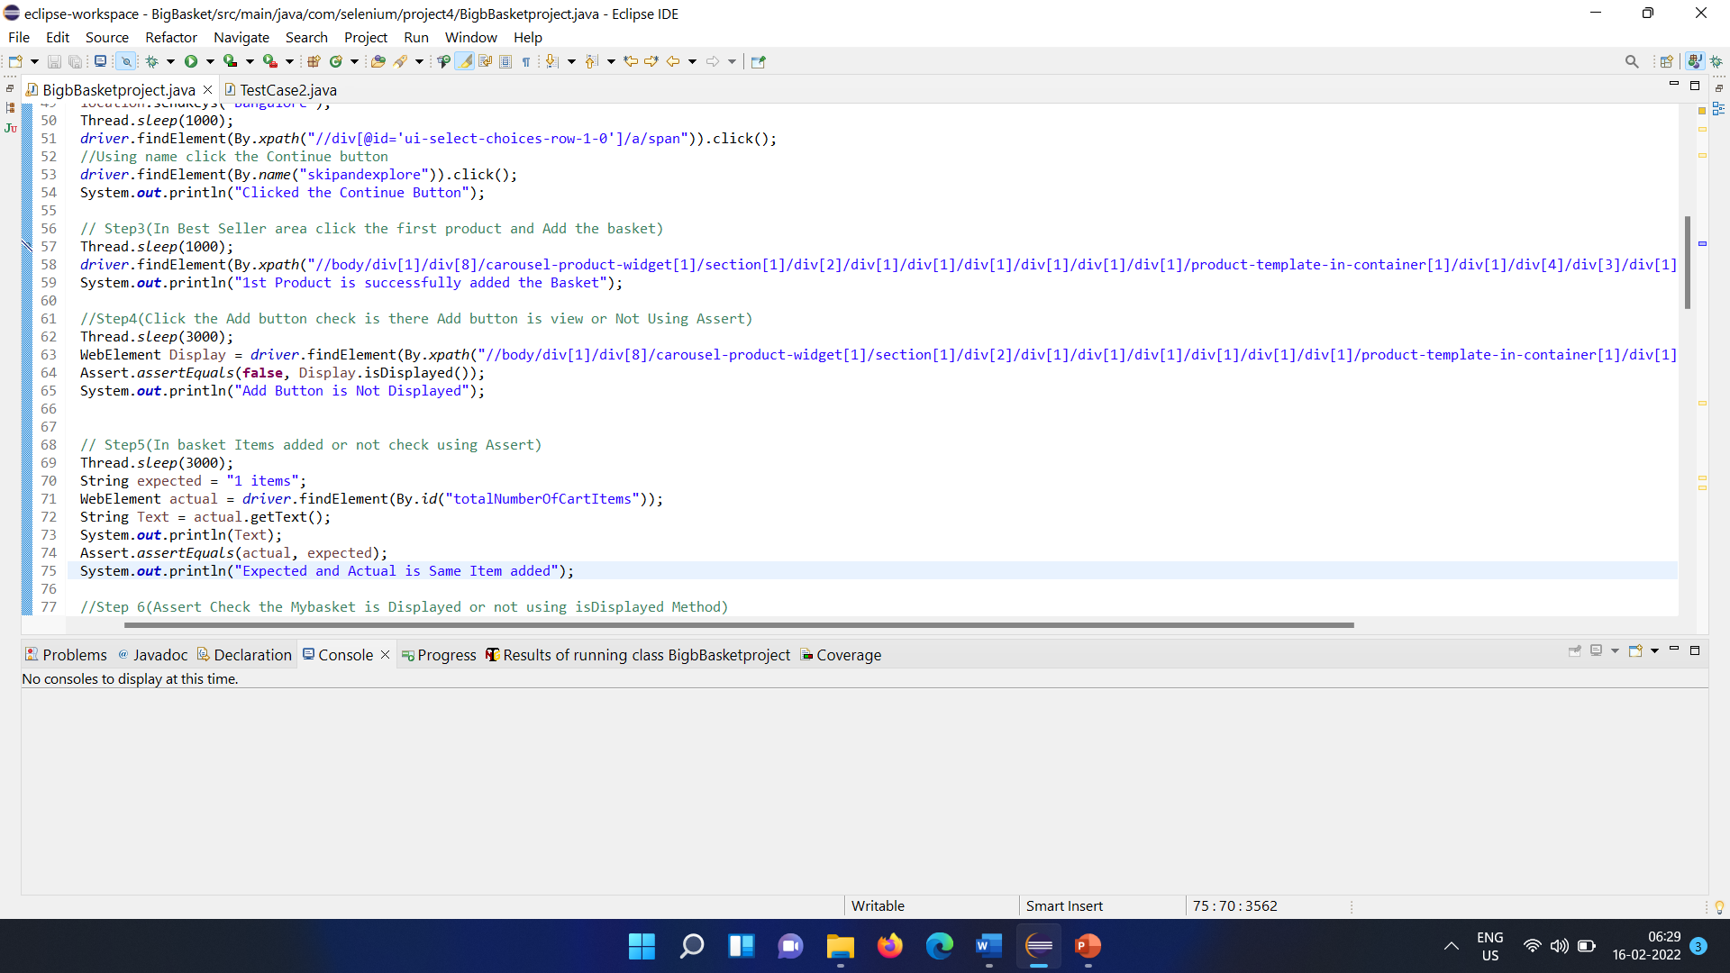
Step 3
Add the first product in the Best Sellers area to the Basket by clicking on the ‘Add’ button.
Step 4
Assert that the ‘Add’ button that was clicked above is no more visible.
STEP 5
Assert that the ‘My Basket’ view on the top right of the webpage is updated to show ‘1 items’.

Slide 8
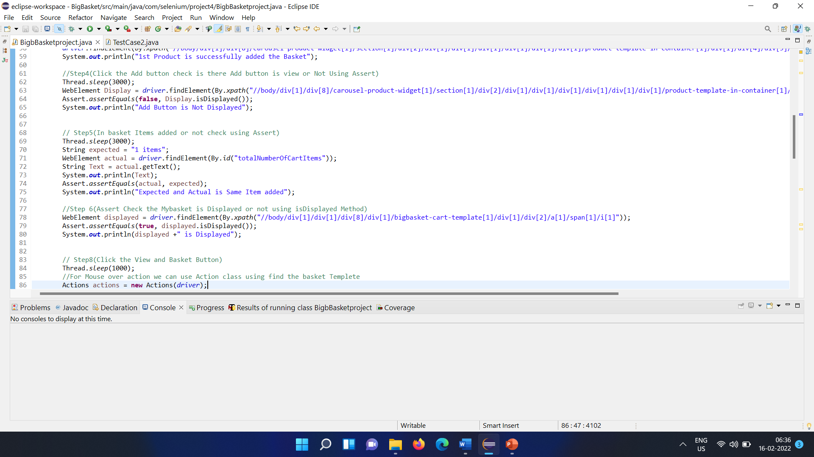
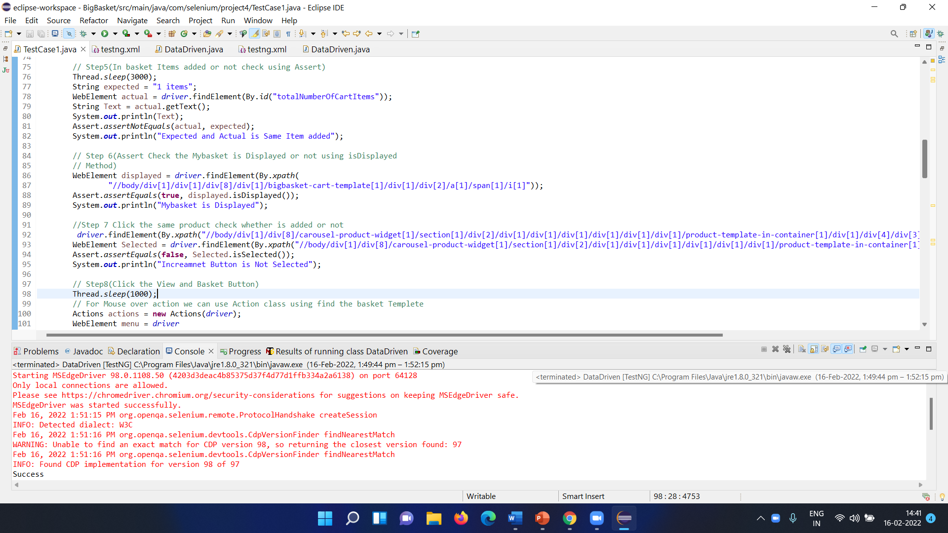
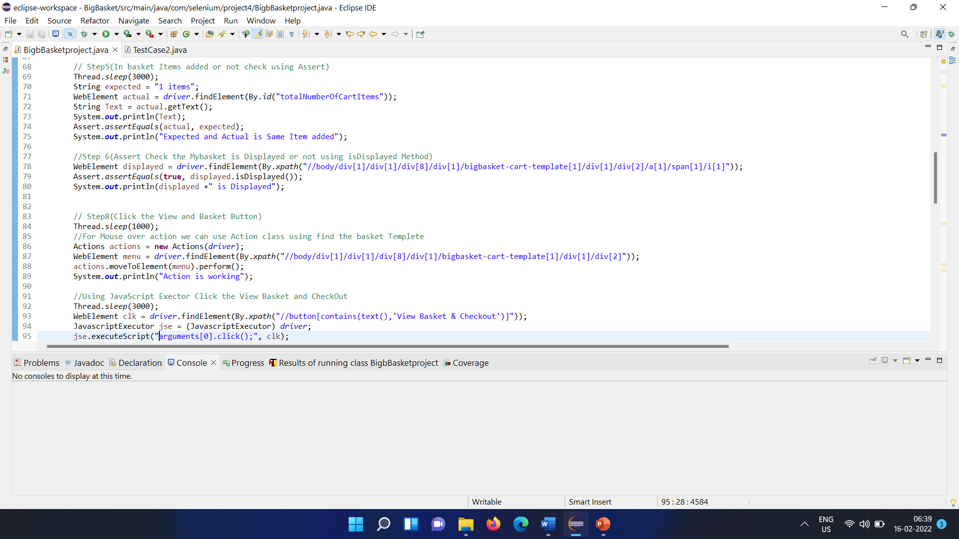
Step 6
Hover over the ‘My Basket’ view.
Step 7
Assert that the same product that was selected in step 2 is added.
Step 8
Click on the ‘View Basket and Checkout’ button.

Slide 9
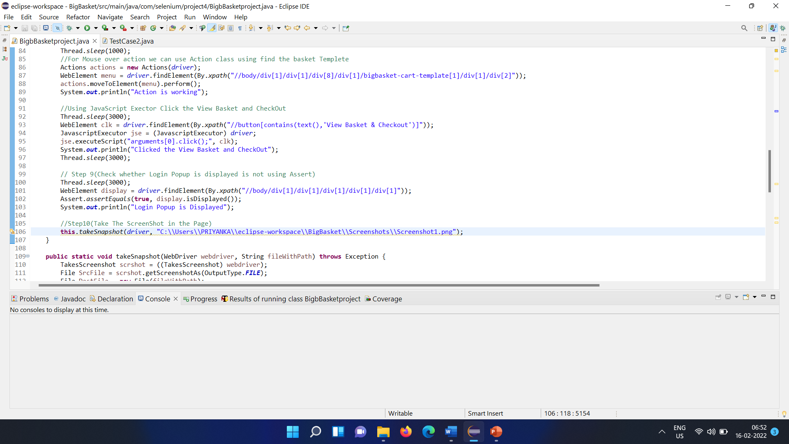
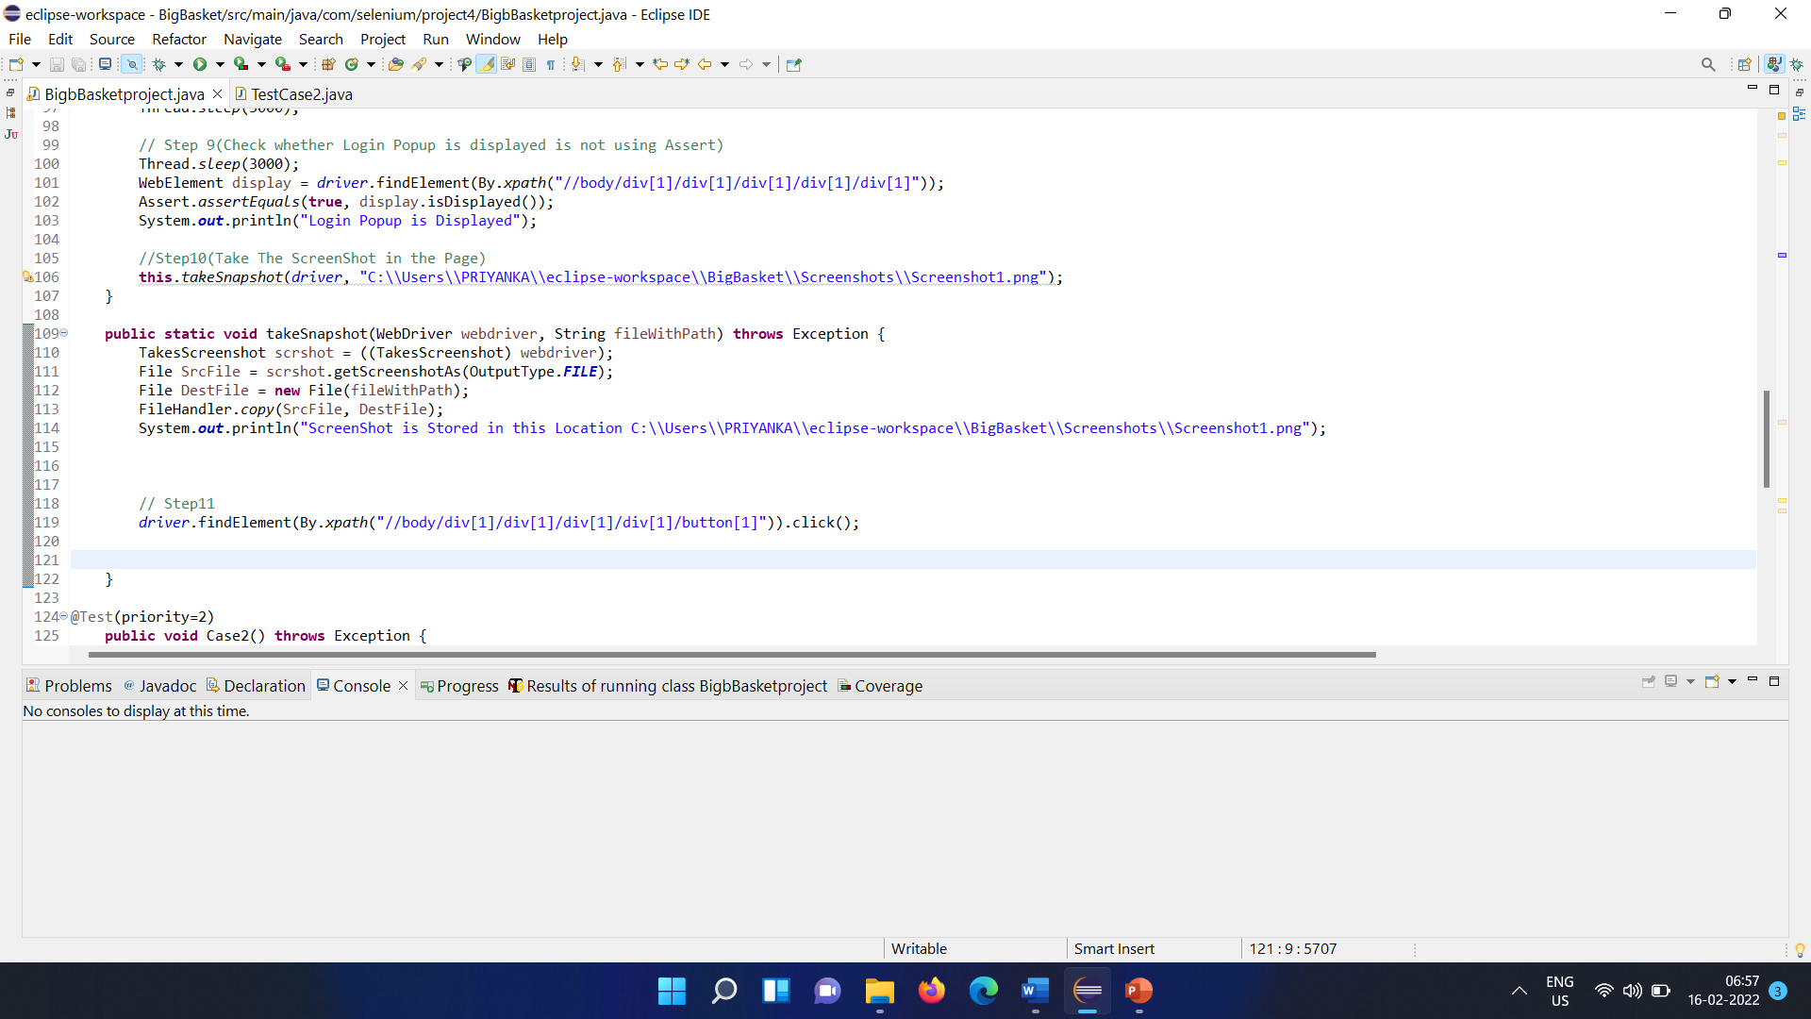
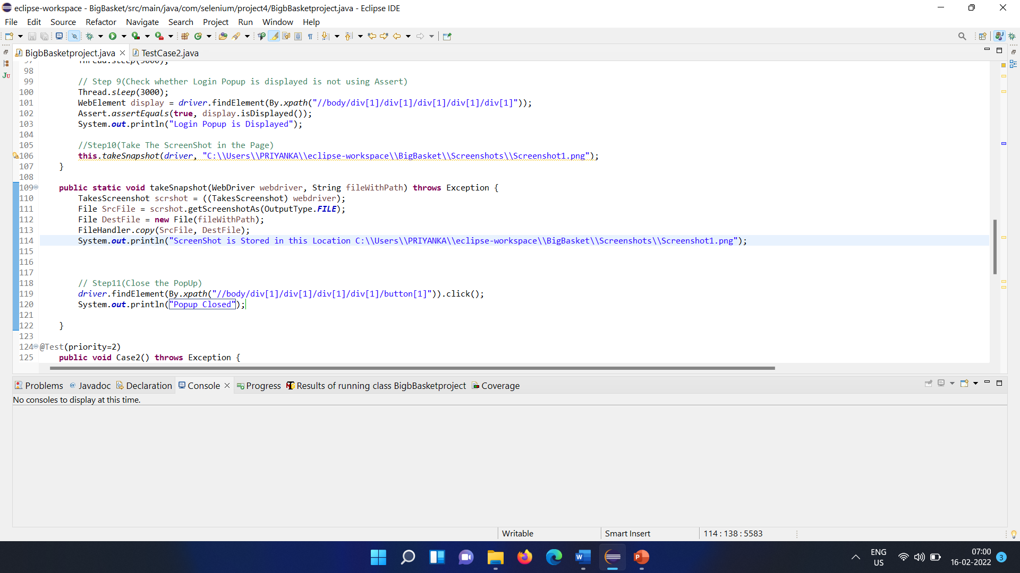
Step 9
Assert that the login popup is displayed.
Step 10
Take a screenshot of this page.
Step 11
Close the popup

Slide 10
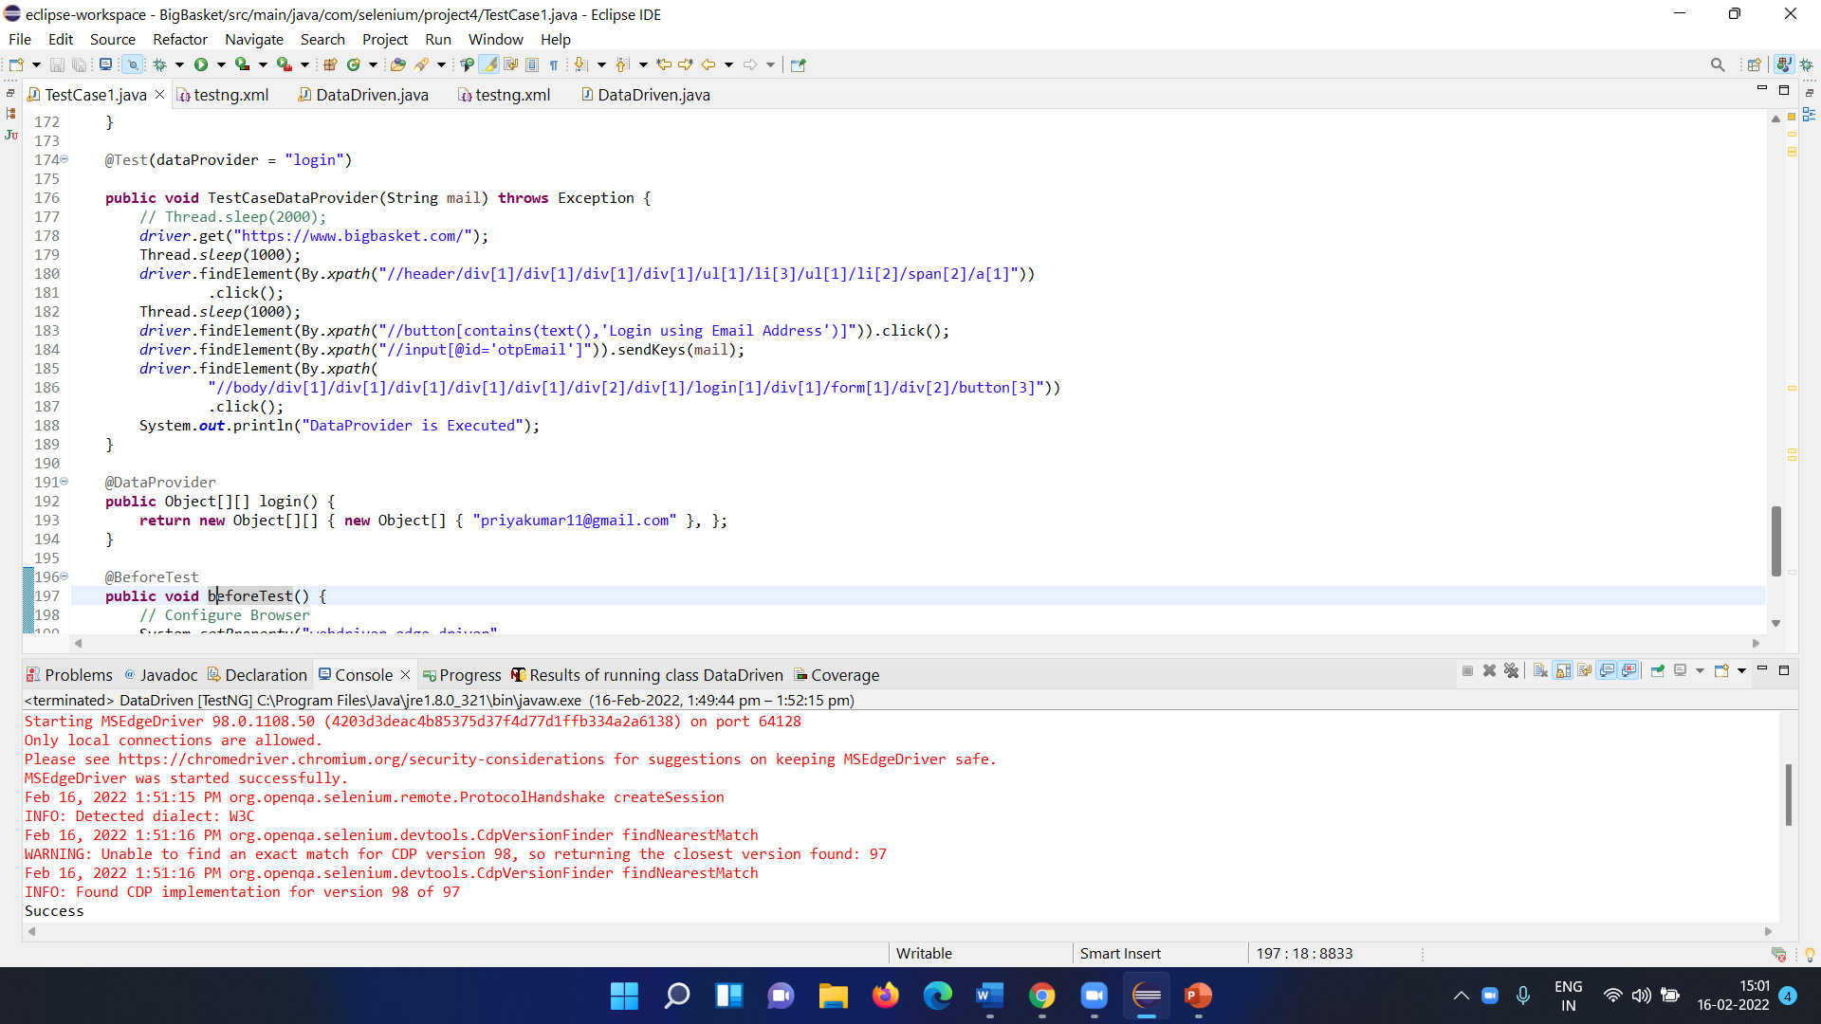
DATAPROVIDER CODE:

Slide 11
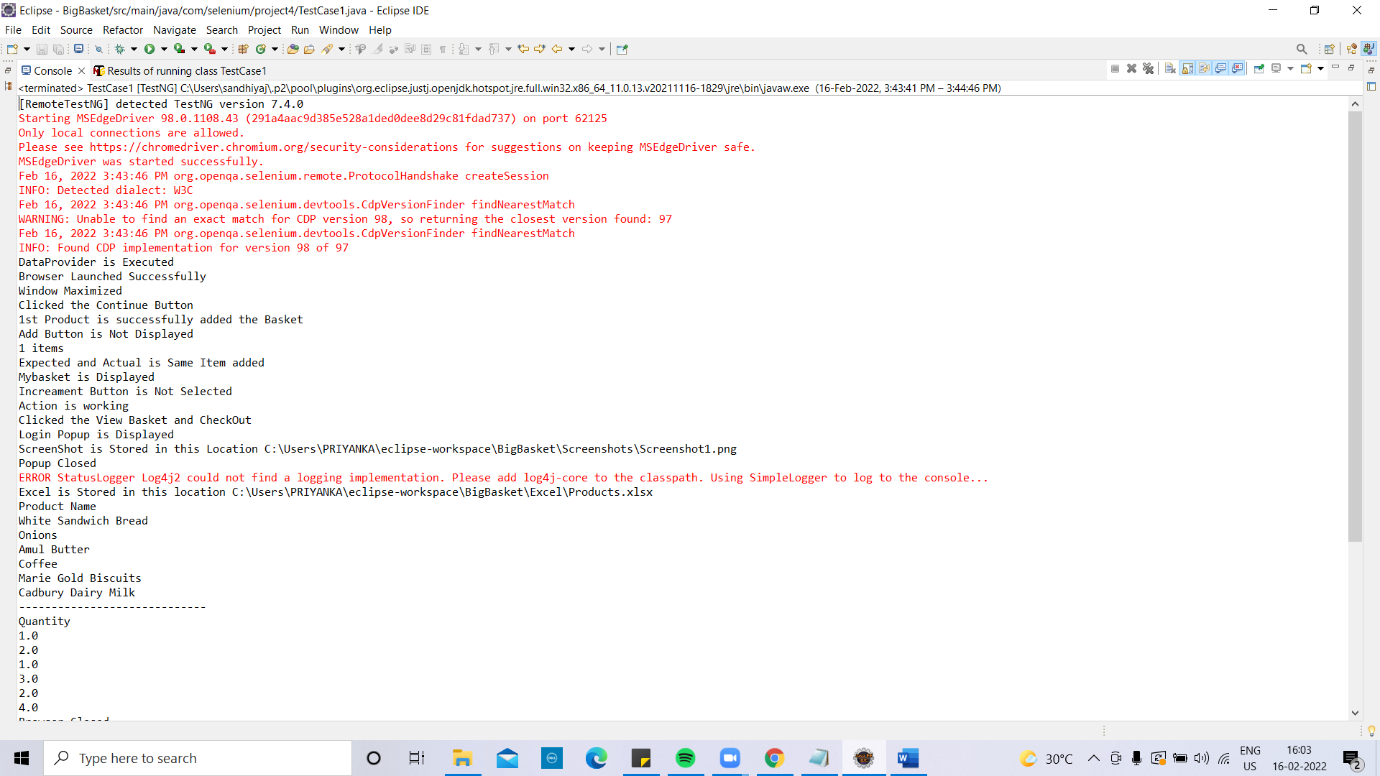
OUTPUT (PART –A)

Slide 12
REQURIMENTS (PART B) Test Data: Create the above Test Data in excel sheet named as ‘Products’.
Test Data:
Create the above Test Data in excel sheet named as ‘Products’.
Product Name | Quantity
White Sandwich Bread | 1
Onions | 2
Amul Butter | 1
Coffee | 3
Marie Gold Biscuits | 2
Cadbury Dairy Milk | 4

Slide 13
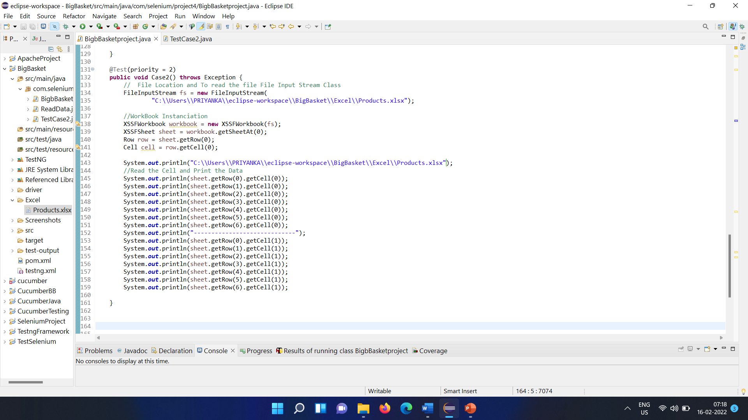
Code:

Slide 14
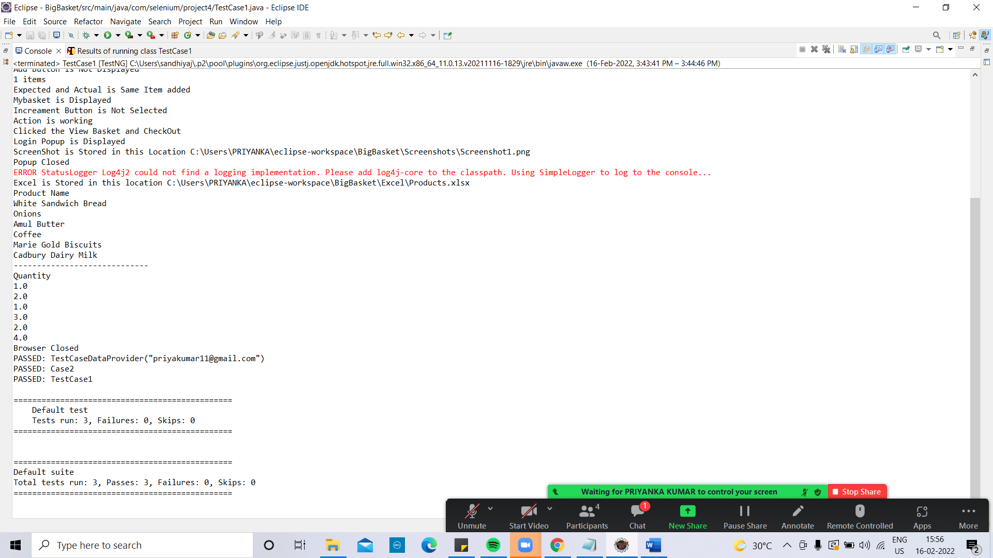
OUTPUT( PART-B)

Slide 15
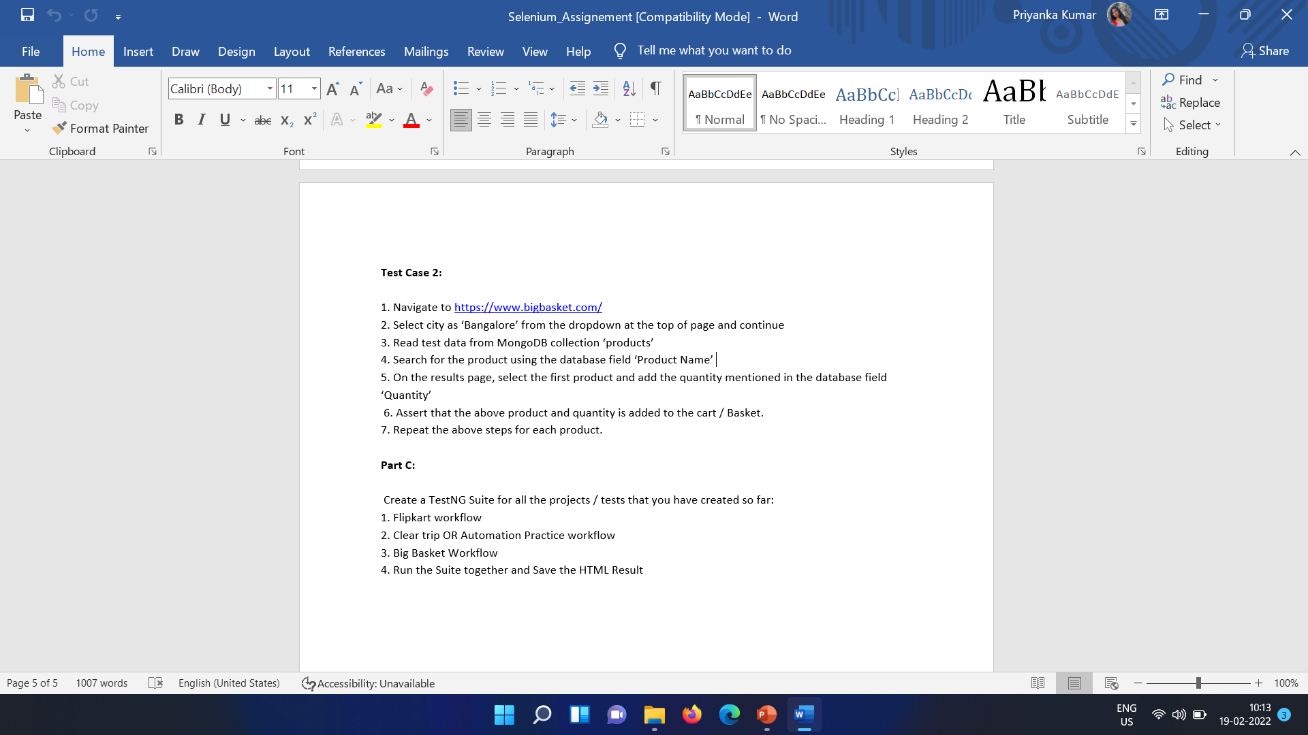
REQUIREMENTS (TEST CASE 2)

Slide 16
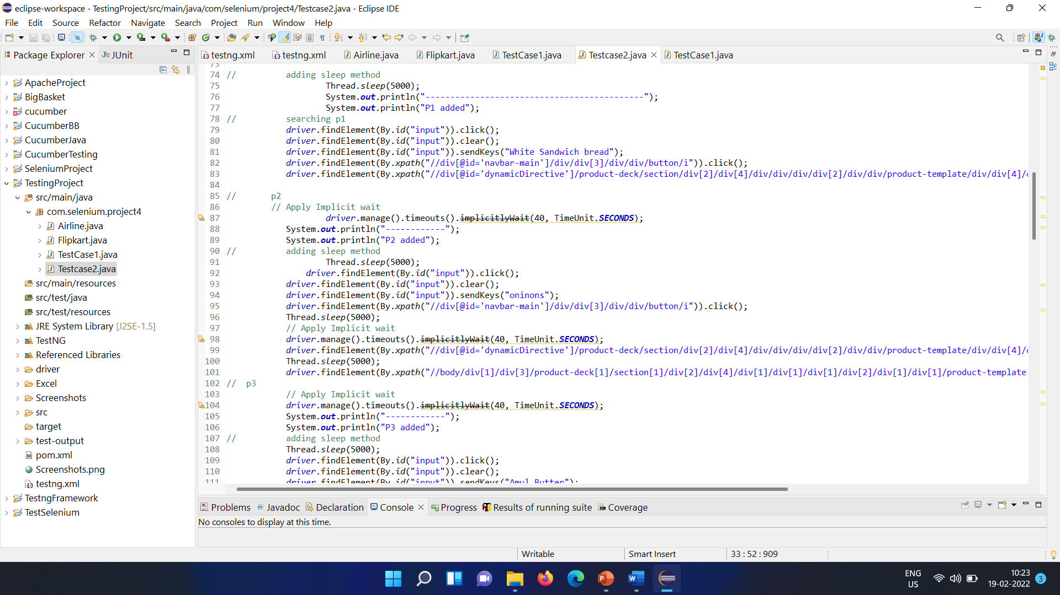
Code:

Slide 17
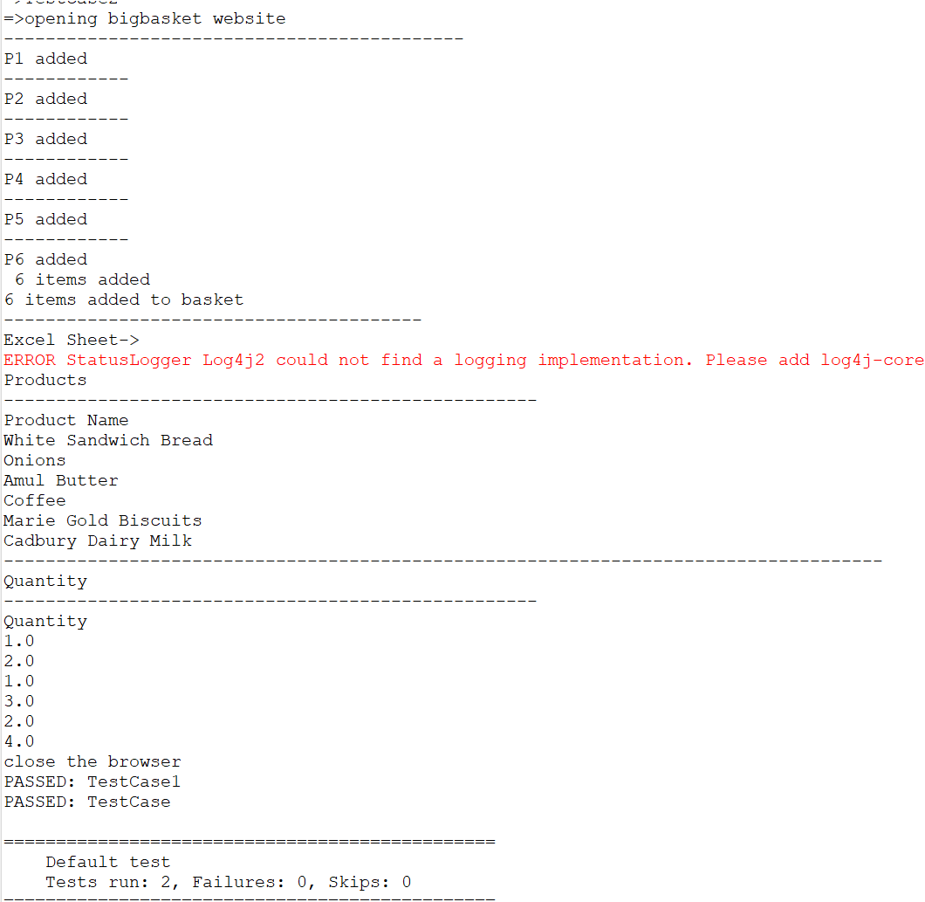
OUTPUT (TEST CASE 2)

Slide 18
REQURIMENT PART –C

Slide 19
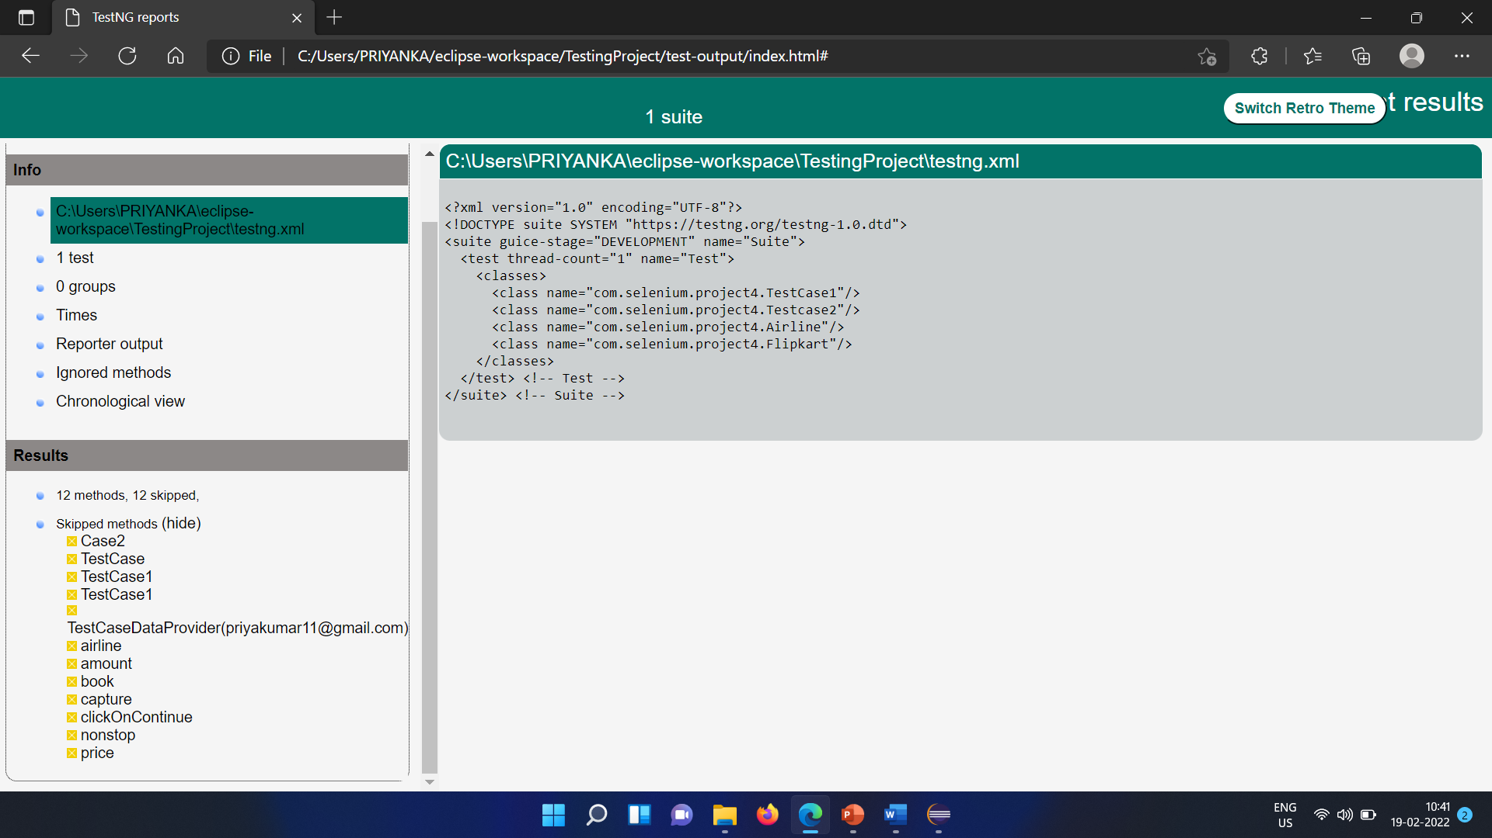
TestNG.xml (Test suite)

Slide 20
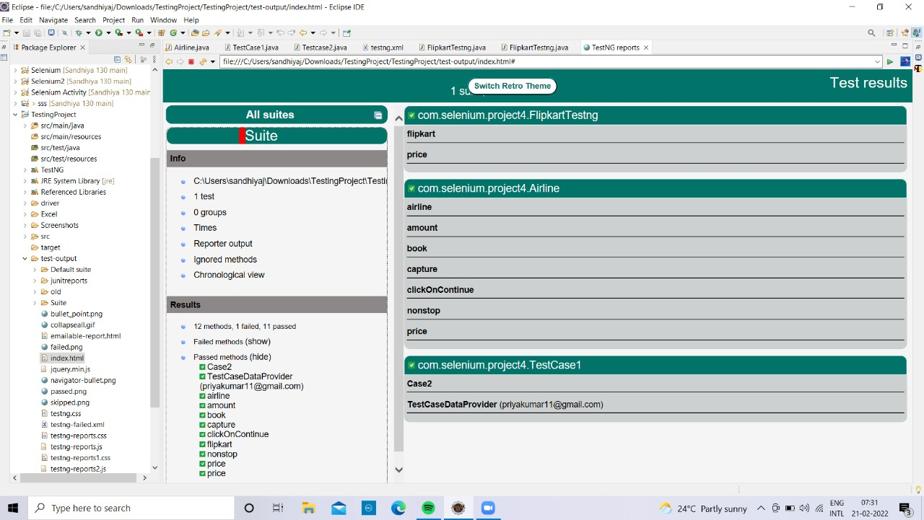
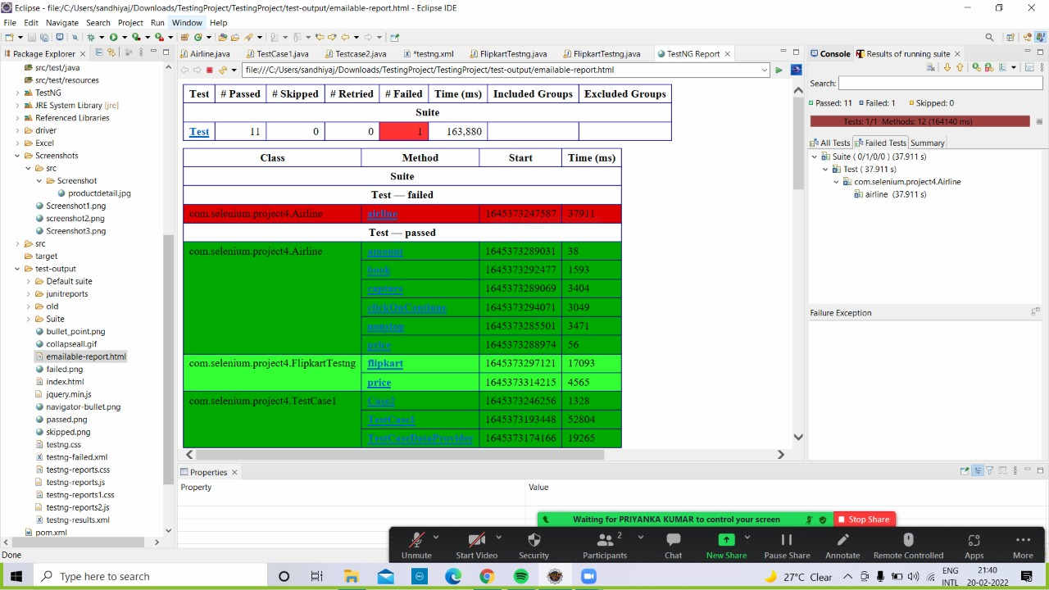
REPORTS :
Index - REPORT
Email - REPORT

Slide 21
Reference
Testcase run video recording link:
https://drive.google.com/drive/folders/1AGDNrkar6AQ5DXRqUU0eR1Wxt_s1NOEf?usp=sharing
Project GitHub URL:
125-priyankakumar/Project-and-Execrise (github.com)

Slide 22
THANK YOU

